Slide 1
Image Steganography Using LSB Technique
Made by- Tanish Gupta, Riya Sawhney, Aniruddha Deb
Indian Institute Of Technology, Delhi

Slide 2
Necessity
Safeguarding Power System Communication Channels from unauthorised use
Confidentiality
Integrity
Availability
Efficiency: Probability of data being hacked no more than that of randomly guessing the data
Sharing the data inconspicuously: only the sender and receiver know about the existence of the cryptic message

Slide 3
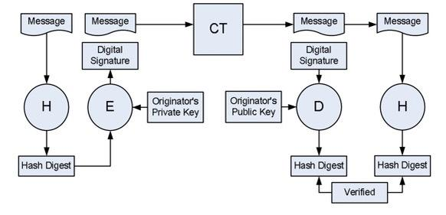
Maintaining Confidentiality and Integrity
CONFIDENTIALITY- data as a stream of bits- using algorithms to alter the bits so that message to be encrypted is well hidden
INTEGRITY- using a small nonce or digest in conjunction with the message to ensure that the message is untampered

Slide 4
Image Steganography Using LSB
Hiding data via images
PNG images: 2D array of pixels with RGB or RGBA parameters
BMP images: 2D images stored as pixel array
Least Significant Bit of the pixel value for a given parameter is modified.

Slide 5
Steps Ahead
Encrypt data to be hidden
Choose which pixels are to be modified
Choose which parameter of pixels is to be modified

Slide 6
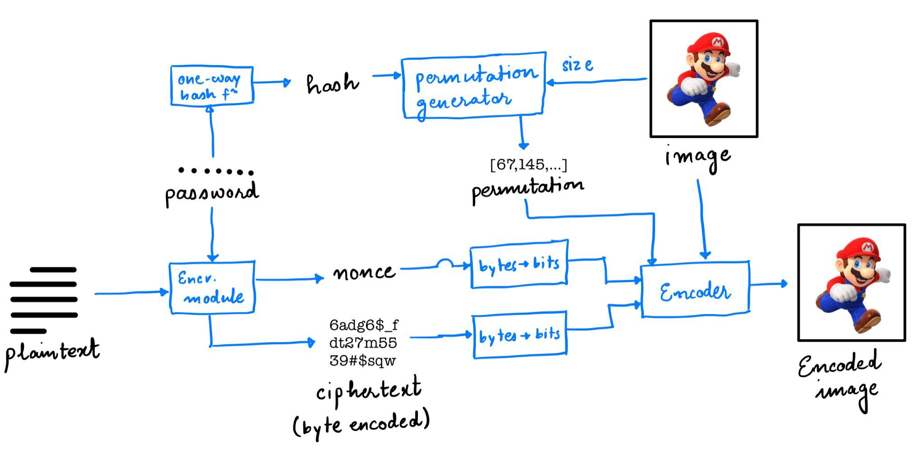
Block Diagram - Encoder

Slide 7
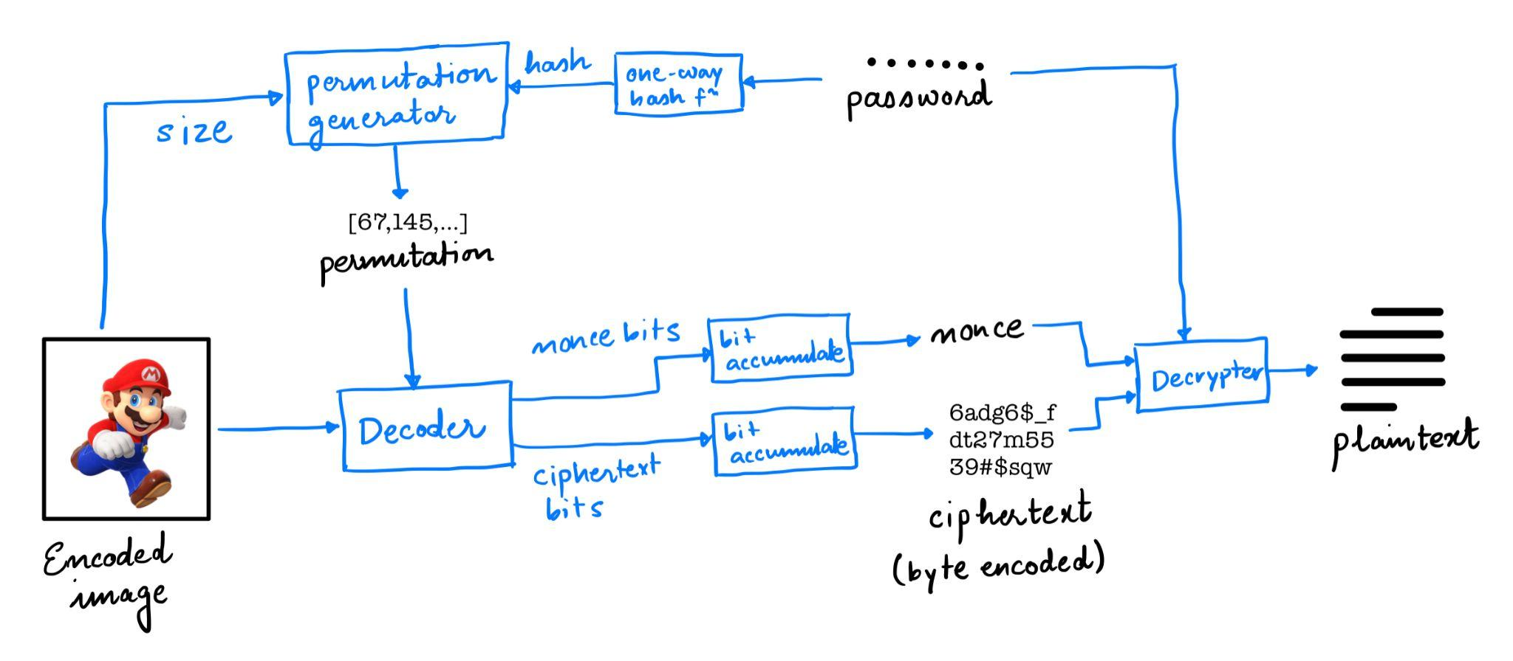
Block Diagram - Decoder

Slide 8
Encoding protocol
First 16 consecutive pixels encode the length of ciphertext
Next 128 (16*8) consecutive pixels encode the nonce
Pixels from the 129th to the last pixel undergo encoding based on the locations given by the permutation generator
Pixels are ordered in row major order: the rank of a pixel is given by (row length)*(row idx) + (col idx)

Slide 9
CODE DEMO

Slide 10
Possible Expansions Of Project
JPEG images- compressed with Discrete Cosine Transform (Lossy): use inverse transforms to uncompress them, apply LSB encryption, then compress them again?
Audio based steganography
Robust Steganography - The ability to recover the final data even if the image is manipulated/information is lost
Use parity bits placed adjacent to permutation locations to ensure parity is maintained
Robustness - Detection tradeoff: hard to achieve a system that optimizes both

Slide 11
References
https://cms-cdn.selinc.com/assets/Literature/Publications/Technical%20Papers/6345_CryptographyTutorial_dew-rs_20081020_Web2.pdf?v=20181015-211749
https://en.wikipedia.org/wiki/BMP_file_format#Pixel_array_(bitmap_data)
https://medium.com/swlh/lsb-image-steganography-using-python-2bbbee2c69a2

